Slide 1
实验：Tacotron with Style as Latent Varible
PRESENTED BY hujk17
1

Slide 2
01
实验结果
CONTENTS
02
工程性
03
计划
2

Slide 3


01.声音结果
3

Slide 4
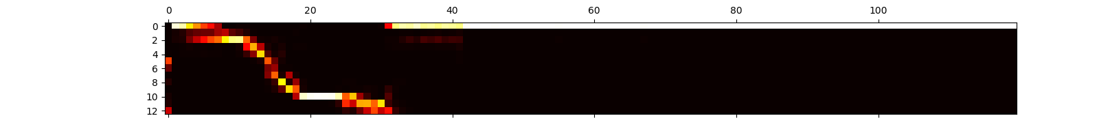
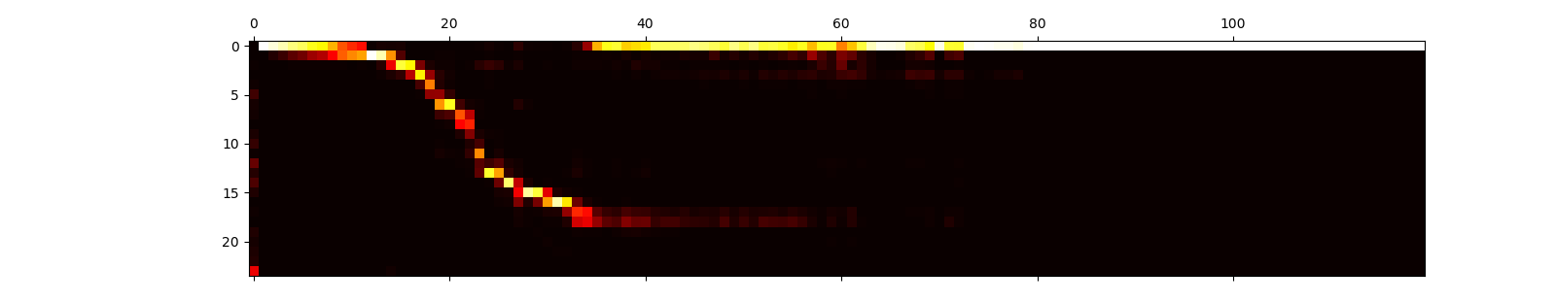
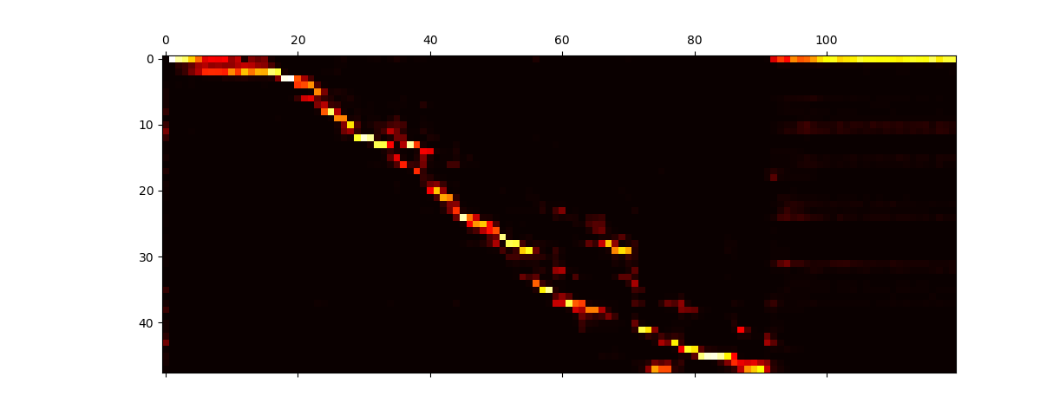

01 参数结果
Attention for text
4
Attention for style

Slide 5




1.5 参数结果
Attention for style
Attention for text
http://219.223.173.21:6006/
5

Slide 6
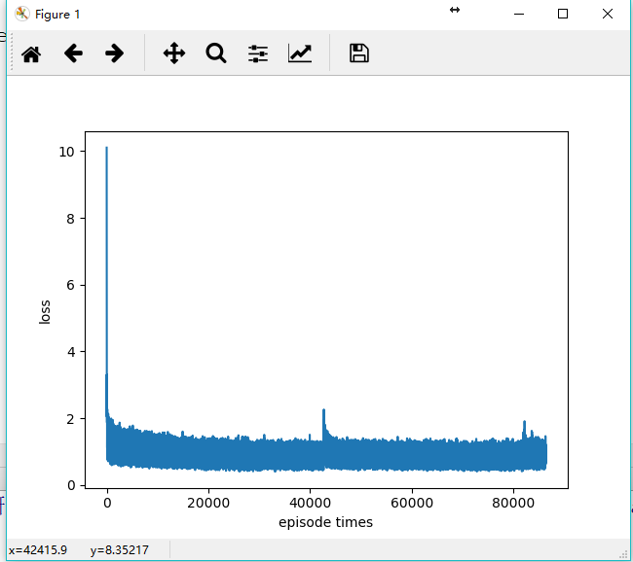
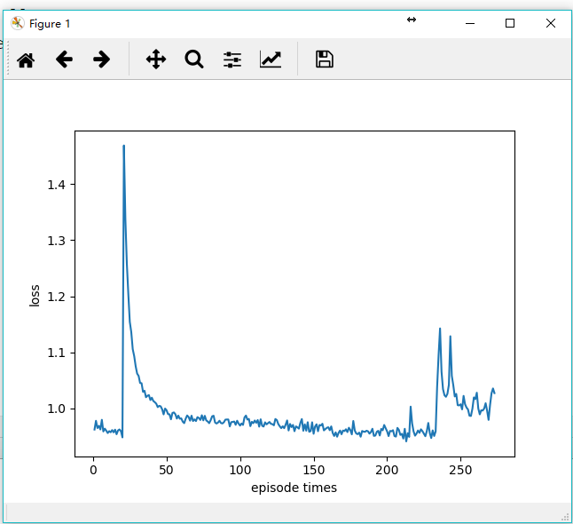
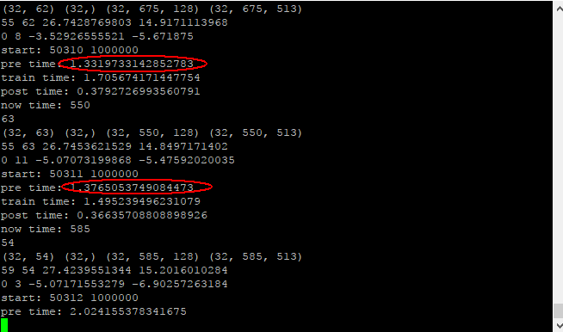

1.5 loss和多线程
6

Slide 7
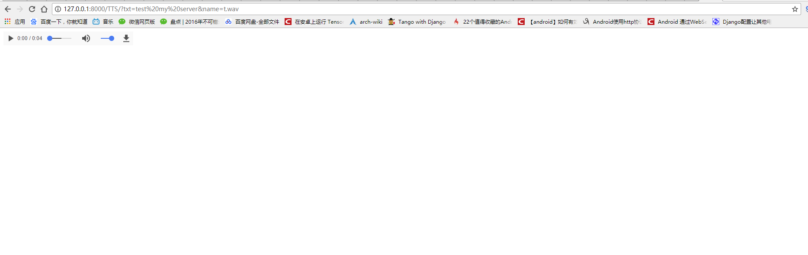
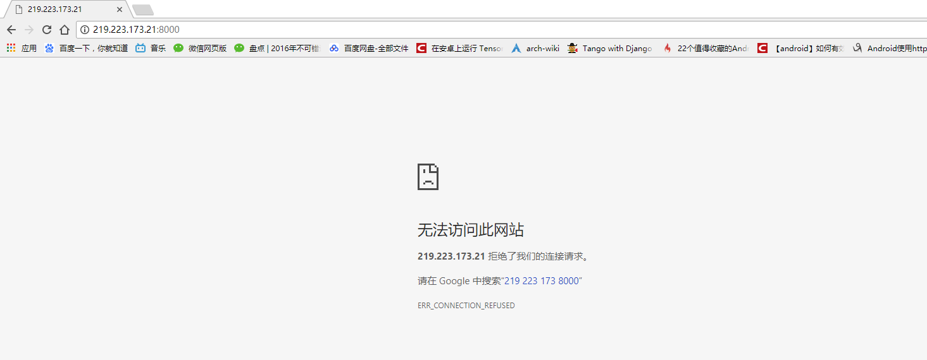
02 web server
在本地可以，但是在服务器上开server，本地访问不到
7

Slide 8
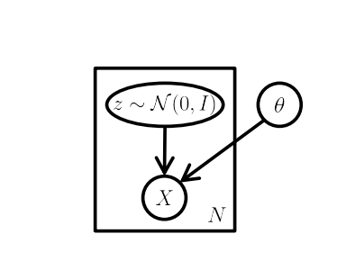
03 下一步计划
Wang Y, Skerry-Ryan R J, Xiao Y, et al. Uncovering Latent Style Factors for Expressive Speech Synthesis[J]. arXiv preprint arXiv:1711.00520, 2017.
Doersch C. Tutorial on variational autoencoders[J]. arXiv preprint arXiv:1606.05908, 2016.
Henter G E, Lorenzo-Trueba J, Wang X, et al. Principles for learning controllable TTS from annotated and latent variation[C]//Proc. Interspeech. 2017: 3956-3960.
8

Slide 9
谢谢大家

